Slide 1
Pooled-analysis vs. meta-analysis: a brief overview
Soutrik Banerjee

Slide 2
Rationale for combining studies
Often several studies are performed, which measure the same outcome
Of which, quite a few studies may not be able to detect a significant association owing to insufficient statistical power
This complicates the decision making process due to inconsistencies of results from different studies
Pooled-analysis and meta-analysis, both could eventually increase the statistical power
Blettner et al., 1999

Slide 3
Why not pooled-analysis ?
Because it is easy to carry out and yields greater statistical power
A common practice is to pool the results of the studies in order to estimate a common (or pooled) parameter estimate
E.g., summing the numerator and summing the denominator separately, and thus obtaining the pooled proportion at the end
However, this creates a major problem in that studies with large populations will get more weights → biased results
This means if one study has, e.g., 80% of the total no. of subjects of all studies, then that study would “pull” the average mean toward itself by sheer number

Slide 4
Why meta-analysis ?
Greater precision of estimates (coming from greater statistical power)
Investigate heterogeneity between the different studies (Q-statistic, Breslow-Day test of heterogeneity)
Summarise the results into a single value
Investigate rare outcomes
Finally, authorities are asking more and more for meta-analyses for decision making

Slide 5
Two types of meta-analysis (e.g., OR)
Fixed-effects – where there is no statistically significant heterogeneity between studies
Peto’s method – this method works pretty well (even if cells have zero counts), but gets biased when OR are relatively further from the null
Mantel-Haenszel’s method – this method is unbiased, but if cells have zero counts, then a correction needs to be applied
Comment: The weights given to the individual studies are obtained from the inverse of the within-study variances.
Random-effects – where there is statistically significant heterogeneity between studies
DerSimonian-Laird method
Comments: The weights given to the individual studies are obtained from the inverse of the sum of within-study variances and between-study variances (τ²). The latter term can be interpreted as the between-study heterogeneity. In this method, if τ² ≤ 0, the ORs become equal to that from the Mantel-Haenszel’s method
Yusuf et al., 1985; Greenland & Robins, 1985; DerSimonian & Laird, 1986

Slide 6
Comparison between fixed-effects and random-effects meta-analysis
RE type MA yield larger variances → wider confidence intervals (often)
Where there is significant heterogeneity, τ² will dominate in the weights → all studies will be weighted more or less closely
In the FE type MA, the studies with larger within-variances will be lowly weighted and vice-versa
τ² is the unexplained heterogeneity, which could not be explained in the MA. In order to investigate the source of heterogeneity, a meta-regression may be performed

Slide 7
Meta-analysis can be performed on various kinds of estimates
Odds Ratios (Peto, Mantel-Haenszel; DerSimonian-Laird)
Risk Ratios (Mantel-Haenszel; DerSimonian-Laird)
Risk Differences (Mantel-Haenszel; DerSimonian-Laird)
Continuous outcomes (Hedges-Olkin; DerSimonian-Laird)
Proportions
Historically, it started from a meta-analysis on correlation coefficients by Karl Pearson (1904)
Cochrane collaboration open learning material

Slide 8
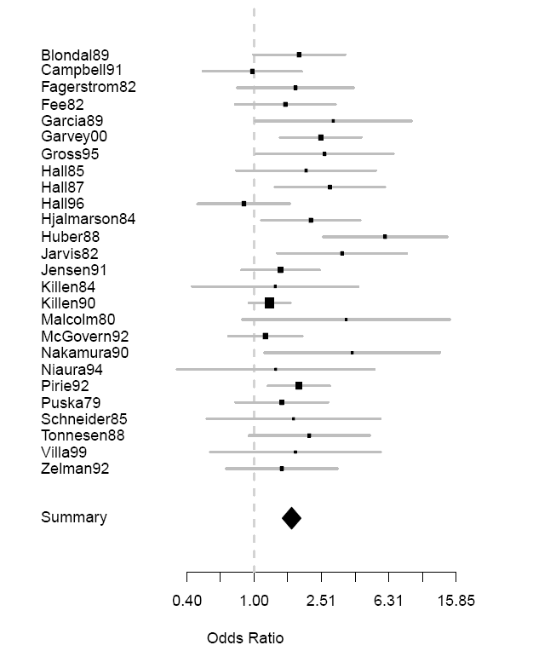
An illustrated example: forest plot
A series of randomised clinical trials were conducted to study if nicotine chewing gums were effective in quitting smoking
The individual study ORs (box) and OR_{meta} (lozenge) are plotted with 95% confidence intervals
The impact upon confidence interval, i.e., precision is clearly apparent

Slide 9
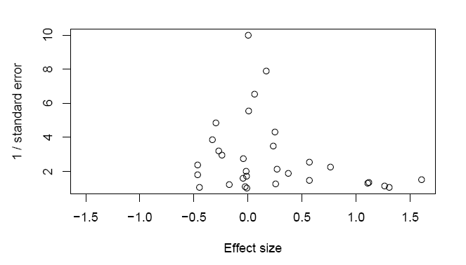
An illustrated example: publication bias
Funnel plot: asymmetry is a hint towards publication bias

Slide 10
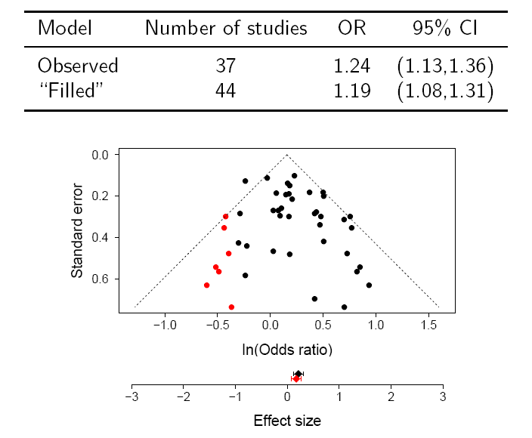
Another example of publication bias
Trim & fill method (plot) to investigate publication bias quantitatively

Slide 11
Criteria for study selection
Given the possibility of publication bias and potential criticism of meta-analysis, selection criteria for the studies is of utmost importance:
Literature search: a well-defined defined protocol (e.g., a clear definition of outcome, a clear definition of exposure), inclusion / exclusion criteria for the studies (e.g., exclude duplicate studies)
Investigation of publication bias and between-study heterogeneity following conduct of the meta-analysis
If any analysis of subgroup to be performed

Slide 12
Software
R (free)
Stata (commercial)
SAS (commercial)
Comprehensive meta-analysis (commercial)
RevMan (free, Cochrane)
Etc.

Slide 13
Further issues in HTA
Indirect comparison of efficacy as well as adverse effects outcomes, e.g.,
(Drug A_{i} – placebo A_{i}) => Risk Difference A_{meta}
(Drug B_{i} – placebo B_{i}) => Risk Difference B_{meta}
Risk Difference A_{meta} – Risk Difference B_{meta} [± 95% CI]
Bayesian meta-analysis
Network meta-analysis using Bayesian methods

